Slide 1
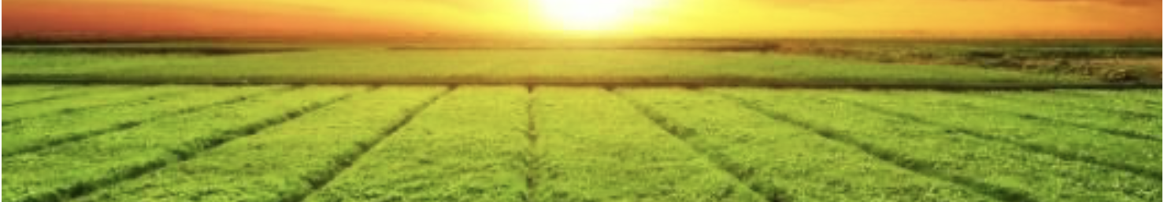
Crop Recommendations Using Machine Learning Algorithms
Technical Audience Presentation
Kim K. Hixson

Slide 2
Introduction, Background, Goal
Precision agriculture is in trend nowadays
It helps the farmers to get informed decision about the farming strategy
The data used to enable these informed decisions is based on a dataset that was built by augmenting datasets of rainfall, climate and fertilizer data available from farms in India
Goal:
Explore and optimize various predictive models to recommend the most suitable crops to grow for a farm based on various parameters within dataset
Source of Data: (https://www.kaggle.com/atharvaingle/crop-recommendation-dataset)

Slide 3
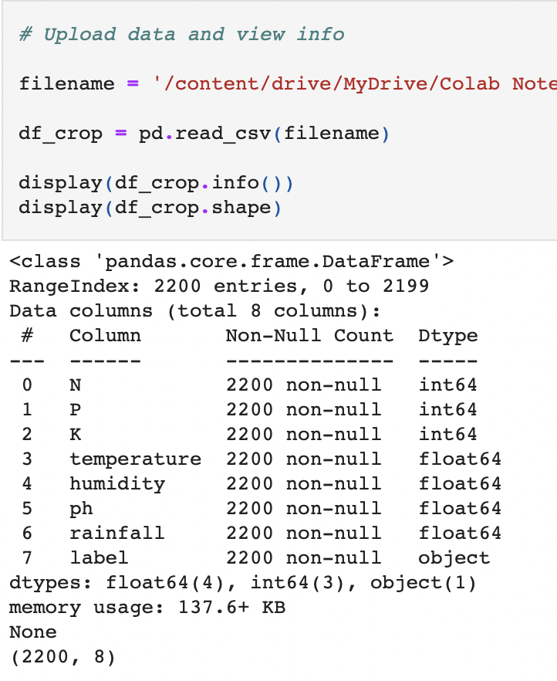
Assessment of Data Cleaning Needs
Using the Google Collaboratory Environment which is a Python Jupyter notebook that runs in the cloud and which is linked to Google’s Drive environment data from Kaggle was uploaded and viewed
info() method and shape attribute of numpy showed me that the dataset contained 2200 rows and 8 columns consisting entirely of numeric data except for ‘label’ (target) column
The dataset contained no missing data
value_counts() of the ‘label’ column revealed 22 different crops and each crop category had 100 datapoints for each feature showing that the dataset is perfectly balanced for ML purposes

Slide 4
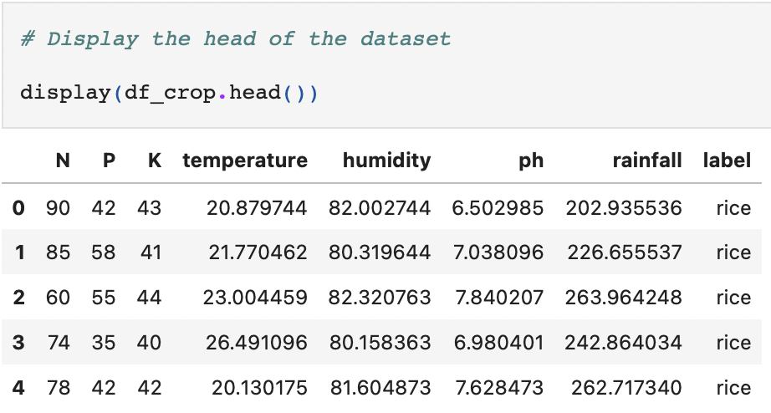
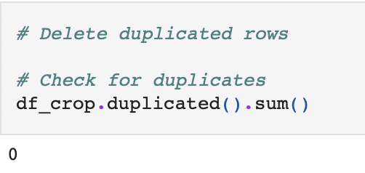
Data Cleaning Steps Implemented
In looking at the head() of the dataset, there appeared to be no unnecessary data columns (i.e., unique identifiers or columns with the same information throughout – it was deemed that all columns were appropriate for machine learning
In looking for duplicated rows, there were none found
In assessing the ‘label’ column (target vector), there were no naming errors of need to coerce them to a single name
Overall Data Cleaning Assessment: There were no missing values, no duplicated rows, and no unnecessary columns. The data appeared to already be in a form that was cleaned for ML.

Slide 5
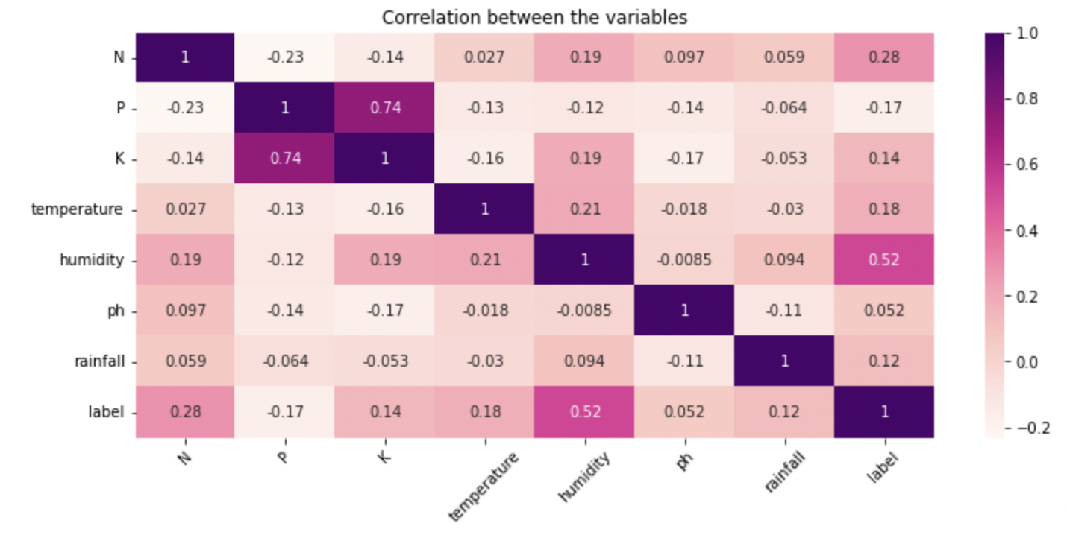
Exploratory Visual 1: Correlation Plot
Phosphate (P) and potassium (K) values are highly correlated to one another.
Individually P and K will contribute similar levels of variance to the model
Our crops ‘label’ target vector is most correlated to humidity and least correlated to pH. Humidity will have a large affect on our model while pH may have negligible affect

Slide 6
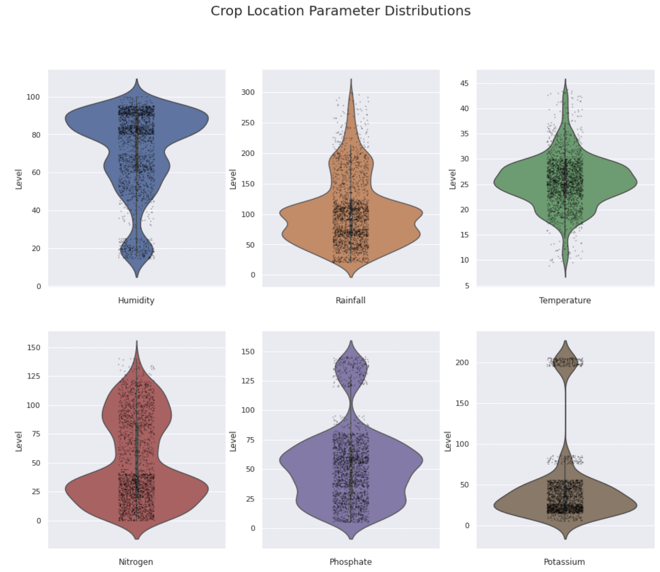
Exploratory Visual 2: Violin and Strip Plots
Distribution of Crops According to Parameter
Most crops required high humidity
Most crops required relatively low levels of rainfall, nitrogen, phosphate, and potassium
Most crops were grown in moderate temperatures

Slide 7
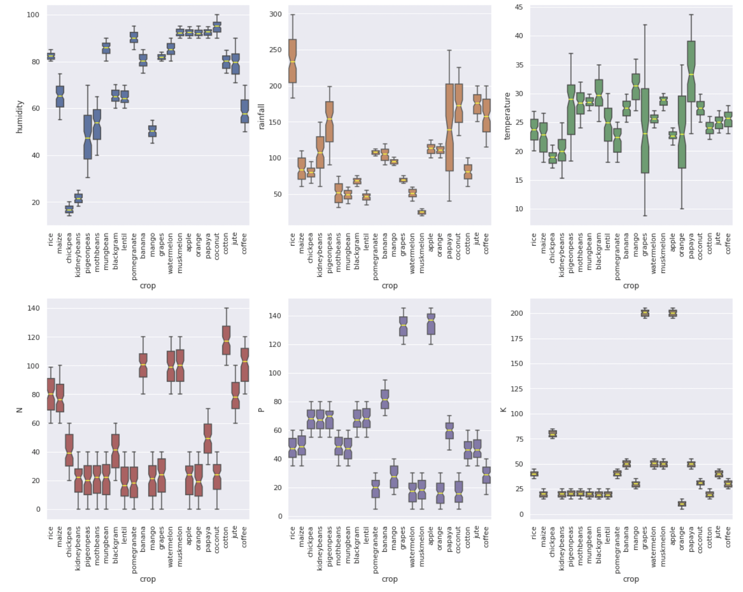
Exploratory Visual 3: Box Plot Distributions
Chickpeas and Kidney beans require low humidity
Rice requires the most rainfall
Banana, Watermelon, Muskmelon, Cotton, and Coffee require high N levels
Grapes and apple require high phosphate
Grapes and apple also require high potssium
Distribution of Individual Crops within each Parameter

